Slide 1
CLS PROGRAM OVERVIEW

Slide 2

Program overview
What is the CLS Program?
Who can apply?
What do CLS participants do during the summer?

Slide 3

Background
Established through the National Security Language Initiative
Funded by the U.S. Government
Supports national security and economic prosperity
Prepares students to compete and lead in the global workforce
Notes:
U.S. leadership abroad—in business, global affairs, and security—rests on Americans who can navigate other languages and cultures with expertise and fluency. The Critical Language Scholarship (CLS) Program delivers intensive summer language instruction to high-achieving undergraduate and graduate students, selected through a competitive, merit-based process. Offered overseas or virtually, the program condenses a full academic year of language study into eight weeks of rigorous instruction and cultural immersion. Since 2006, the CLS Program has equipped more than 10,000 U.S. participants with the linguistic skills, regional knowledge, and global networks to advance U.S. interests worldwide.

Slide 4
Offerings
Language Offered | Beginner Level (Less than 1 year of prior study required) | Higher Levels (1+ years of prior study required or the equivalent)
Arabic, Chinese, Japanese, Korean, Russian | Virtual | Overseas
Hindi, Persian, Portuguese, Swahili | Overseas | Overseas
Notes:
This year, the CLS Program will offer instruction in nine different languages. Each language will be offered at four different levels: beginning, advanced beginning, intermediate, and advanced.
Five of our languages – Arabic, Chinese, Japanese, Korean, and Russian – will be offered virtually at the beginning level.
Four of our languages – Hindi, Persian, Portuguese, and Swahili – will be offered overseas at the beginning level.
While beginning-level options vary by format, every language is available overseas at the advanced beginning level and above.
For CLS, advanced beginning typically means at least one academic year – or two semesters – of prior study.

Slide 5
Eligibility
✓
U.S. status
U.S. citizen or national
VIRTUAL
INSTITUTES
✓
Enrollment
Degree-granting program at a U.S.-based institution
Open to undergraduates only.
✓
Age
At least 18 by May 15, 2027
GRADUATING?
✓
College study
One full year completed before the program begins
Graduating seniors and one-year master's students may apply.
✓
Language level
Any prerequisite completed by the start of the program
Notes:
To be eligible for the CLS Program, students must be U.S. citizens or nationals enrolled in a degree-granting program at a U.S.-based institution when they apply. They must be at least 18 years old by May 15, 2027, and have completed one full year of college-level study before the program begins.
Both undergraduate and graduate students may apply, including graduating seniors and students in one-year master's programs. However, only undergraduate students are eligible to apply for virtual language institutes. If you have questions about your specific situation, please reach out to cls@americancouncils.org.
The CLS Program welcomes students from all majors and academic disciplines. Students at all levels of language learning can prepare a competitive application, although some language levels require prior study. That prior experience does not have to come only from college coursework. Applicants may also draw on self-study, tutoring, high school classes, heritage language experience, or other learning experiences and explain their background in the application.
Students applying to a level with prerequisites must meet those requirements by the start of the program in June. If you're unsure whether your experience meets a language requirement or which level is the best fit, please reach out to cls@americancouncils.org.

Slide 6
CLS is an intensive eight-week commitment
A shared schedule creates the focus and consistency needed for accelerated learning.
8
18
1
weeks
hours
primary commitment
between June and August
weekly class instruction
for the duration of the program
Plan around the CLS schedule and set aside outside obligations during the program.
CLS is not a research, independent study, or internship program.
Notes:
The 2027 CLS Program will take place over eight weeks between June and August. Across overseas and virtual institutes, participants complete intensive language instruction and structured cultural activities. At overseas institutes, faculty and staff at host institutions also facilitate in-person programming that helps participants build language skills and connect with their cohort.
Because the CLS Program is intensive, participants should be prepared to make the program their primary commitment during the summer. Overseas participants should plan to set aside outside obligations such as independent travel, research, or internships. Virtual participants should expect live, daily weekday classes and regular homework. Other commitments may be possible, but participants should understand that the CLS Program requires significant time, focus, and preparation.

Slide 7
Language learning extends beyond the classroom
Participants practice, connect, and learn through a coordinated set of experiences.
01
02
03
04
Language classes
Language partners
Cultural programming
Consistent engagement
Intensive instruction
and 1:1 consultations with teachers
Everyday conversation
and community connection
Activities, speakers,
and local perspectives
Immersive practice in and out of the classroom
Together, these experiences support strong language gains and the
development of skills needed for global leadership.
Notes:
Beyond structured language classes, students also participate in cultural activities designed to deepen their understanding of the communities who speak their target language. These activities may include experiences such as tea ceremonies, calligraphy lessons, guest speakers from the local community, virtual cultural programming, and visits to historic sites.
In addition to language classes, participants are assigned language partners from their host communities to help them practice everyday conversation skills. Language partners offer more than an additional opportunity to use the language; they can also serve as a bridge to the host community. Through these relationships, students engage more deeply with the people and cultures connected to their target language and gain perspectives that extend beyond the formal curriculum.
The CLS Program emphasizes the importance of fostering meaningful engagement with the people and cultures connected to the language being studied. Whether through interactions with language partners, cultural programming, conversations with community members, or daily life in the host community, participants build relationships that support both language learning and cultural understanding. For participants in overseas institutes, this also includes living with host families or alongside local students to further support immersion.
These experiences are also an important part of citizen diplomacy. Throughout the program, CLS participants represent the United States in their everyday interactions with language partners, teachers, classmates, host families where applicable, and others in the community to their language of study. After the program, they apply what they have learned, seen, and heard through those relationships, and can share more nuanced perspectives about the people and cultures they encountered through the CLS Program.

Slide 8
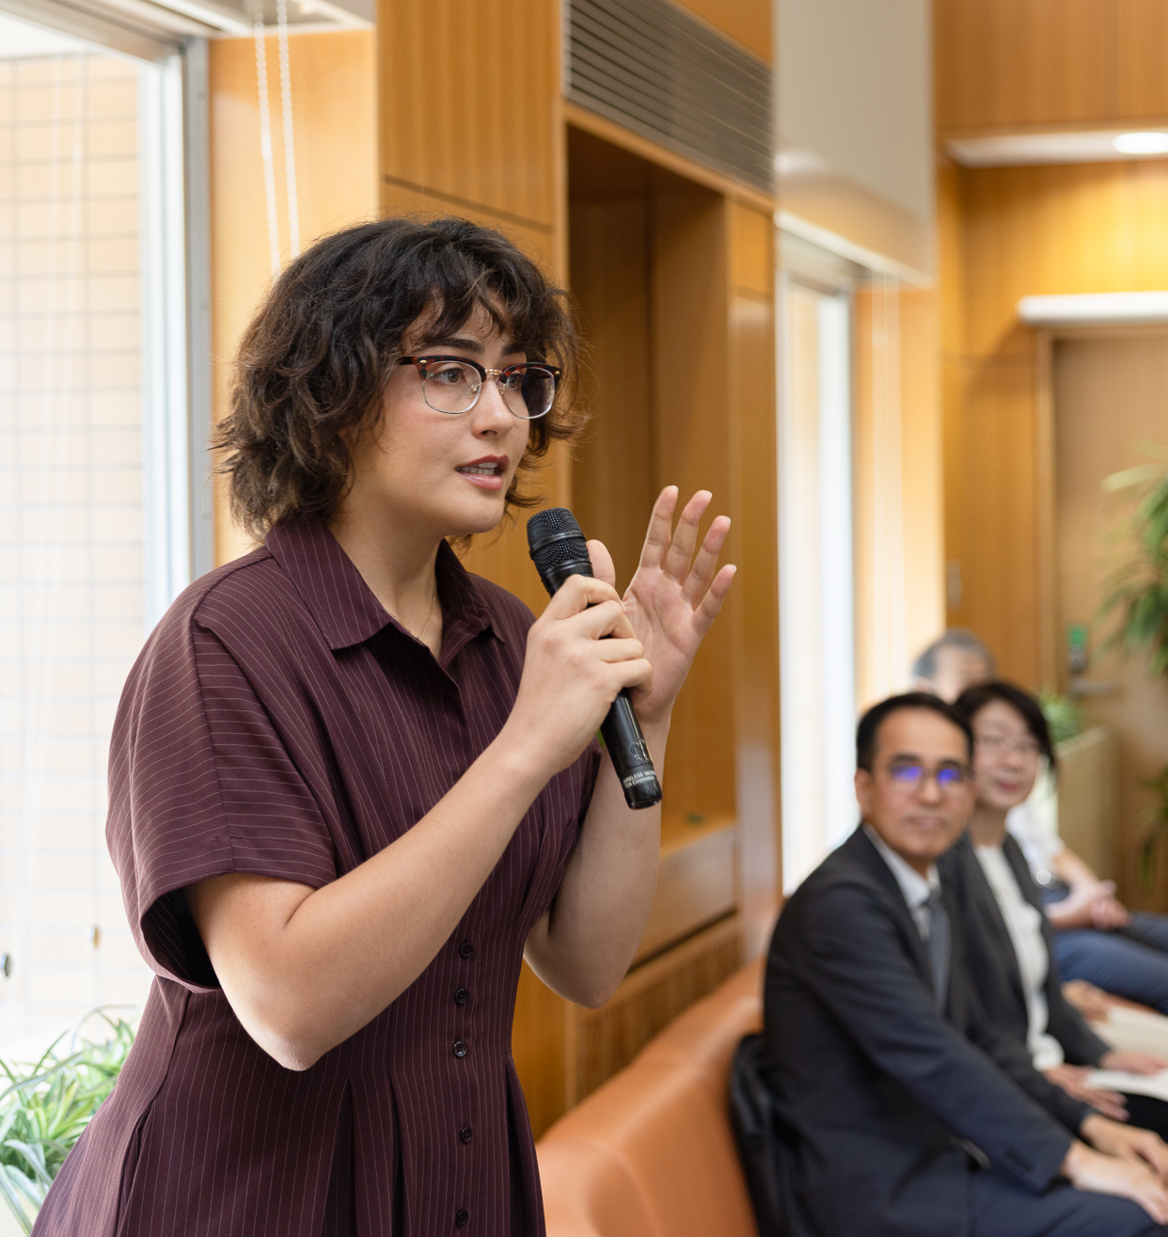
Program funding and benefits
Language growth, academic value, and a network that lasts.

Slide 9
CLS funding helps participants focus on intensive language study
All participants
Overseas institutes
Virtual institutes
Language instruction
Textbooks and class materials
Program-sponsored cultural programming
Round-trip international airfare
Applicable visa fees
Housing and meals
Program-sponsored group activities
Supplemental equipment and connectivity stipend
Covered examples include a web camera or microphone
Program coverage differs slightly by institute format.
Notes:
The CLS Program is funded by the U.S. Department of State. Costs covered for the program include language instruction, textbooks and class materials, and cultural enrichment experiences.
Participants in the overseas institutes also receive round-trip international airfare in addition to any applicable visa fees, housing and meals, and the cost of program-sponsored cultural programming and group trips in the host country.
Participants in virtual institutes receive a stipend to be used for supplemental equipment and connectivity costs, such as a web camera or microphone.

Slide 10
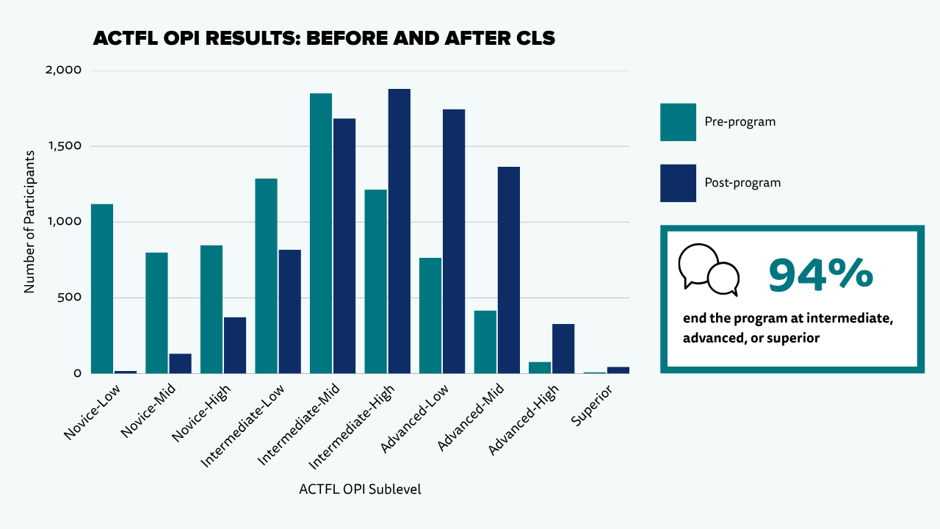
CLS participants…
Make substantial gains in language skills.
Complete two semesters worth of college-level language study, with academic credit available through Bryn Mawr College.
Receive ACTFL OPI certificate certifying language proficiency.
Notes:
CLS Program participants make significant gains in their language abilities as a result of participating.
In eight weeks, participants complete the equivalent of one year of college-level language study and make significant, documented language gains.
At the end of the program, participants receive an official ACTFL Oral Proficiency Interview score, and for those who opt in, academic credit is issued through Bryn Mawr College.

Slide 11
CLS alumni continue applying language and regional knowledge
96%
68%
66%
55%
strengthened language proficiency and cross-cultural communication
report stronger workforce readiness and career development
apply regional knowledge at work
use their CLS language in their current job
Data from the 2025 CLS Long-term Impact Survey
Notes:
The program's value doesn't end when participants come home — it shows up in their careers.
In the 2025 Long-term Impact Survey, 96% of CLS alumni reported stronger language proficiency and cross-cultural communication skills — near-universal agreement that the experience delivered on its core promise.
Two-thirds report it improved their workforce readiness and career development, and 66% say they actively apply regional knowledge in their jobs today.
Perhaps the most telling number is the last one: 55% use their CLS language in their current position. More than half of alumni are putting a critical language to work — which is exactly the return this investment is designed to produce. But those outcomes aren't just the product of one summer of instruction — they're sustained by what participants gain alongside the language: a cohort, a network, and a credential that keeps opening doors.

Slide 12
CLS benefits continue after the summer
Alumni carry language skills, networks, and experience into what comes next.
Language and Intercultural Competence
CLS Alumni Community
Exchange Alumni Network
Strengthened language skills and a distinctive experience to draw on in future study and work.
A nationwide cohort of students and emerging professionals, with continued alumni opportunities for language learning and professional development
Access to the U.S. Department of State Exchange Alumni network, programming, and professional-development resources.
Academic pathways • Professional opportunities • Continued engagement
Notes:
That's what this next slide is really about — the career and alumni benefits that turn a summer program into a long-term professional asset.
Participants become part of a nationwide cohort of students and emerging professionals who share an interest in language learning and international engagement.
After the program, alumni join a broader network of CLS and U.S. Department of State exchange alumni — which provides access to professional development opportunities, alumni programming, and other resources available exclusively to participants in State Department exchange programs.

Slide 13

Preparing to apply
Show your readiness, explain your goals, and describe your potential contribution.

Slide 14
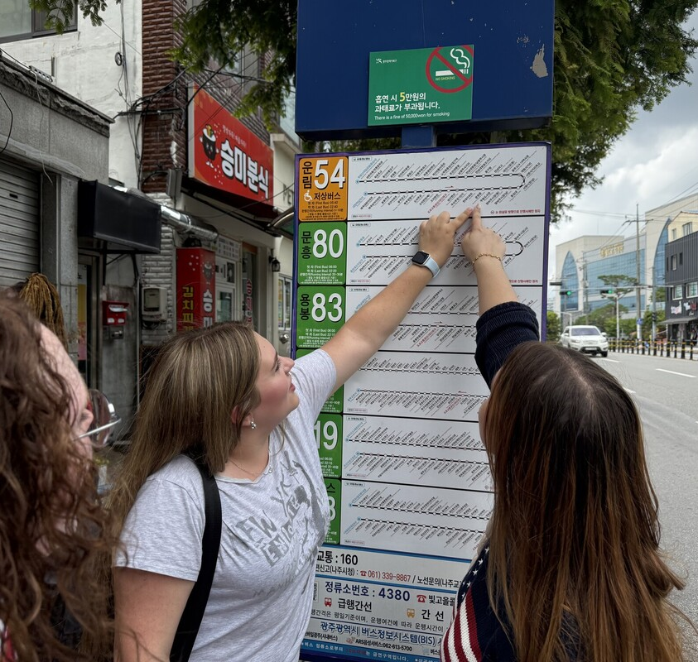
Selection criteria
A strong application connects readiness, goals, and impact
01
Commitment to language learning
02
Preparation for and alignment with
program expectations
03
Connection between language and
academic and professional goals
04
Contribution to citizen diplomacy
05
Contribution to national impact
The CLS Program awards preference to veterans of the U.S. Armed Forces,
in recognition of their service.
Notes:
Applicants for the 2027 CLS Program are selected based on:
Commitment to language learning;
Preparation for and alignment with program expectations;
Connection between language and academic and professional goals;
Contribution to citizen diplomacy; and
Contribution to national impact.
Applicants are not expected to have prior study abroad or international experience.
All other factors being equal, the CLS Program awards preference to veterans of the U.S. Armed Forces, in recognition of their service.

Slide 15
Essay Questions
Commitment to language learning
Citizen diplomacy
Goals + national impact
Why are you committed to studying this language?
How will you use the CLS opportunity to engage with your peers, your host community, and your community back home?
How does CLS support your academic and professional goals? More broadly, how does it contribute to national impact?
Your essays complete your story.
No letter of recommendation required.
Notes:
The application for the 2027 CLS Program includes three short-answer essays. There is no letter of recommendation requirement and no personal statement this year. The essays are designed to help reviewers understand an applicant’s interest in language learning, their readiness for an intensive program, and how they plan to use the experience in the future.
The first essay focuses on commitment to language learning. Applicants will be asked to discuss their interest in their target language and culture, reflect on their language-learning experience to date and how they will adapt to an intensive language program, explain how CLS fits into their goals, and describe how they plan to continue studying the language after the program.
The second essay focuses on citizen diplomacy. Applicants will be asked to reflect on how they will adapt to a new cultural environment, what experiences have prepared them to represent the United States as a citizen diplomat, and how they plan to engage with the people and communities connected to their target language.
The third and final essay focuses on goals and national impact. Applicants will be asked to describe their academic and professional goals, explain how their target language supports those goals, and discuss how they plan to apply the skills and experiences gained through CLS in ways that benefit their communities, fields of study, and the United States.

Slide 16

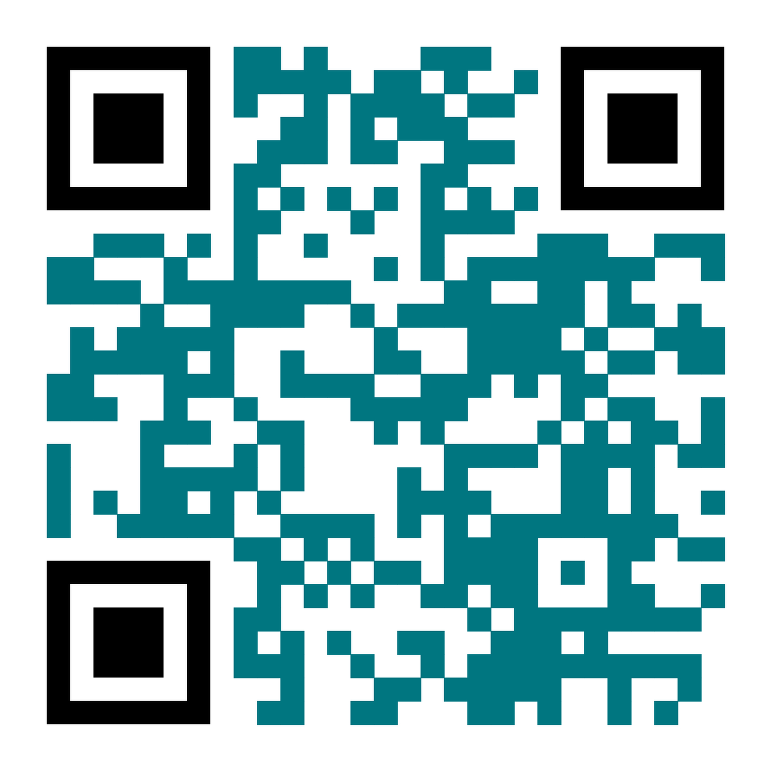
Apply for Summer 2027
DUE NOVEMBER 17
clscholarship.org
Notes:
The application for the 2027 CLS Program is now open and will close on Tuesday, November 17 at 8 PM ET or 5 PM PT. We strongly encourage you to reach out to us early in the process so we can help guide you as you work on your application.
Notifications of semifinalist status will be sent by email in late January 2027.
Finalists, alternates, and non-recipients will be notified by email in early March 2027.
Students who receive an offer will have about two weeks to accept or decline it. If an award is declined, it may be offered to an alternate candidate.

